Slide 1

Bayesian Analysis
A brief introduction
Michael L. Thompson, Ph.D.
April 26, 2021

Slide 2
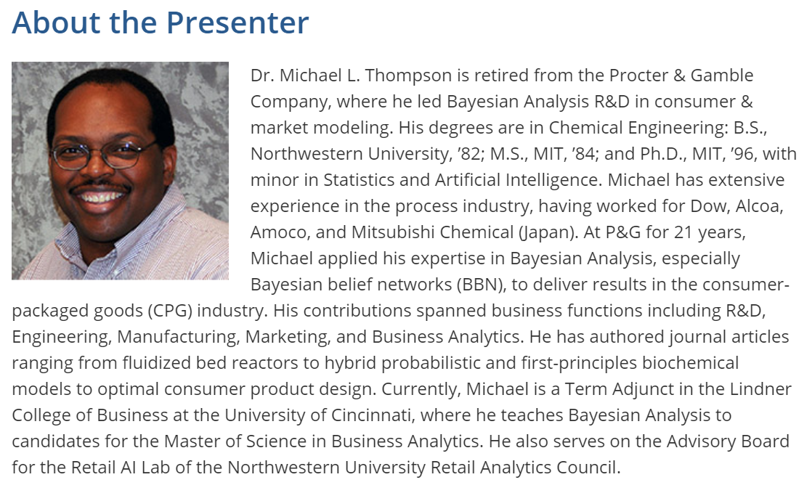
Hidden

Slide 3
Outline
What is Bayesian Analysis?
  Bayes Theorem: Core Concepts
How is Bayesian Analysis applied in AI & Data Science?
  Bayesian Model-based Machine Learning
How do you perform Bayesian Analysis?
  Bayesian Workflow & Tools
When is using Bayesian Analysis most strongly motivated?
  Key Traits to Look for in Your Problems
Where can you learn more about Bayesian Analysis?
  Resources & Readings

Slide 4


What is “Bayesian Analysis”?
Logic
(Reasoning)
Probability Theory
Information Theory
Bayesian
Analysis
Bayesian AI
Bayesian Metrics
Decision
Theory
Statistics
Bayesian Decision Analysis
Bayesian Statistics

Slide 5
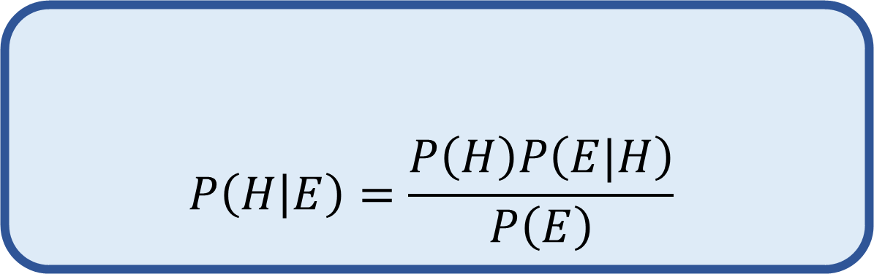
Bayesian Analysis
The application of Bayes Theorem …
  To reason about unknowns by considering evidence, leveraging Probability Theory.
  To infer predictions by transforming data, leveraging Statistical Modeling.
  To decide on actions by accounting for uncertainty, leveraging Decision Theory.
$$P\left(H | E\right)=\frac{P\left(H\right)P\left(E|H\right)}{P\left(E\right)}$$
Bayes Theorem
Posterior
Prior
Likelihood
Marginal Likelihood
Hypothesis
Evidence

Slide 6
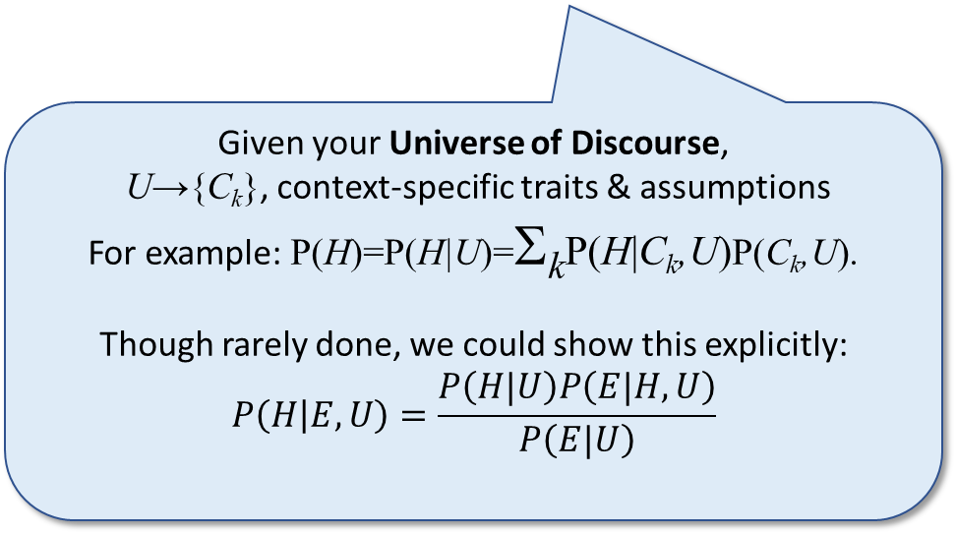

Bayes Theorem
(It has marvelous implications….)
Hidden
Bayesian:
Core Concepts
Probabilities represent your beliefs
  Acknowledge & quantify uncertainty
  Condition upon context –
  all probabilities are conditional
Alternatives given full consideration
  Account for entire joint probability of all possible combinations of evidences & hypotheses
Evidence updates beliefs
  Prior belief is essential, not merely strength of evidence
$$P\left(H | E\right)=\frac{P\left(H\right)P\left(E|H\right)}{P\left(E\right)}$$
Bayes Theorem
Given your Universe of Discourse,
U→{C_{k}}, context-specific traits & assumptions
For example: P(H)=P(H|U)=Σ_{k}P(H|C_{k},U)P(C_{k},U).
Though rarely done, we could show this explicitly:
$$P\left(H | E,U\right)=\frac{P\left(H|U\right)P\left(E|H,U\right)}{P\left(E|U\right)}$$

Slide 7
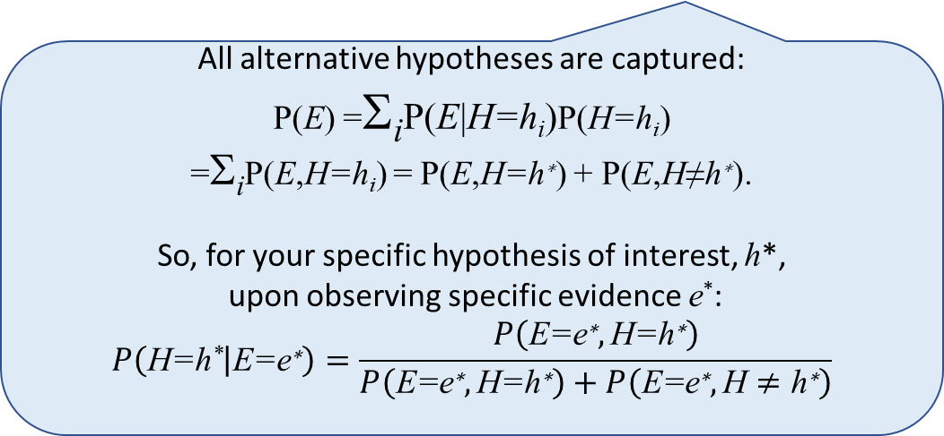
Bayes Theorem
(It has marvelous implications….)
Hidden
Bayesian:
Core Concepts
Probabilities represent your beliefs
  Acknowledge & quantify uncertainty
  Condition upon context –
  all probabilities are conditional
Alternatives are given full consideration
  Account for entire joint probability of all possible combinations of evidences & hypotheses
Evidence updates beliefs
  Prior belief is essential, not merely strength of evidence
$$P\left(H | E\right)=\frac{P\left(H\right)P\left(E|H\right)}{P\left(E\right)}$$
Bayes Theorem
All alternative hypotheses are captured:
P(E) =Σ_{i}P(E|H=h_{i})P(H=h_{i})
=Σ_{i}P(E,H=h_{i}) = P(E,H=$\text{h}\text{∗}$) + P(E,H≠$\text{h}\text{∗}$).
So, for your specific hypothesis of interest, h*,
upon observing specific evidence e*:
$$P\left(\text{H}\text{=}\text{h}\text{∗} | \text{E}\text{=}\text{e}\text{∗}\right)=\frac{P\left(\text{E}\text{=}\text{e}\text{∗},\text{H}\text{=}\text{h}\text{∗}\right)}{P\left(\text{E}\text{=}\text{e}\text{∗},\text{H}\text{=}\text{h}\text{∗}\right)+P\left(\text{E}\text{=}\text{e}\text{∗},\text{H}≠\text{h}\text{∗}\right)}$$

Slide 8
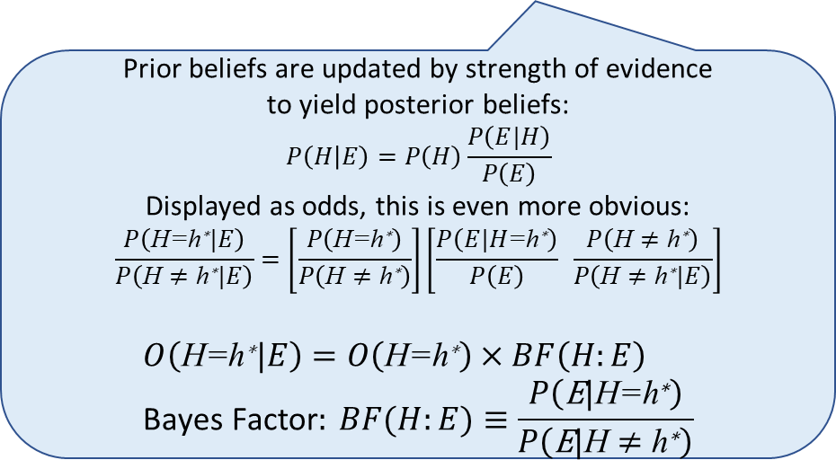
Bayes Theorem
(It has marvelous implications….)
Hidden
Bayesian:
Core Concepts
Probabilities represent your beliefs
  Acknowledge & quantify uncertainty
  Condition upon context –
  all probabilities are conditional
Alternatives are given full consideration
  Account for entire joint probability of all possible combinations of evidence & hypotheses
Evidence updates beliefs
  Prior belief is essential – must not limit consideration to the strength of evidence
$$P\left(H | E\right)=\frac{P\left(H\right)P\left(E|H\right)}{P\left(E\right)}$$
Bayes Theorem
Prior beliefs are updated by strength of evidence
to yield posterior beliefs:
$$P\left(H | E\right)=P\left(H\right)\frac{P\left(E|H\right)}{P\left(E\right)}$$
Displayed as odds, this is even more obvious:
$$\frac{P\left(\text{H}\text{=}\text{h}\text{∗}|E\right)}{P\left(\text{H}≠\text{h}\text{∗}|E\right)}=\left[\frac{P\left(\text{H}\text{=}\text{h}\text{∗}\right)}{P\left(\text{H}≠\text{h}\text{∗}\right)}\right]\left[\frac{P\left(E|H\text{=}\text{h}\text{∗}\right)}{P\left(E\right)} \frac{P\left(\text{H}≠\text{h}\text{∗}\right)}{P\left(\text{H}≠\text{h}\text{∗}|E\right)}\right]$$
$$O\left(\text{H}\text{=}\text{h}\text{∗}|E\right)=O\left(\text{H}\text{=}\text{h}\text{∗}\right)×BF\left(H:E\right) \\ \text{Bayes} \text{Factor}: BF(H:E)≡\frac{P\left(\text{E}\text{|}\text{H}\text{=}\text{h}\text{∗}\right)}{P\left(\text{E}\text{|}\text{H}≠\text{h}\text{∗}\right)}$$

Slide 9
Bayes Theorem
(It has marvelous implications….)
Bayesian:
Core Concepts
Probabilities represent your beliefs
  Acknowledge & quantify uncertainty
  Condition upon context –
  all probabilities are conditional
Alternatives are given full consideration
  Account for entire joint probability of all possible combinations of evidence & hypotheses
Evidence updates beliefs
  Prior belief is essential – must not limit consideration to the strength of evidence
$$P\left(H | E\right)=\frac{P\left(H\right)P\left(E|H\right)}{P\left(E\right)}$$
Bayes Theorem

Slide 10
How is Bayesian Analysis applied in AI & Data Science?

Slide 11
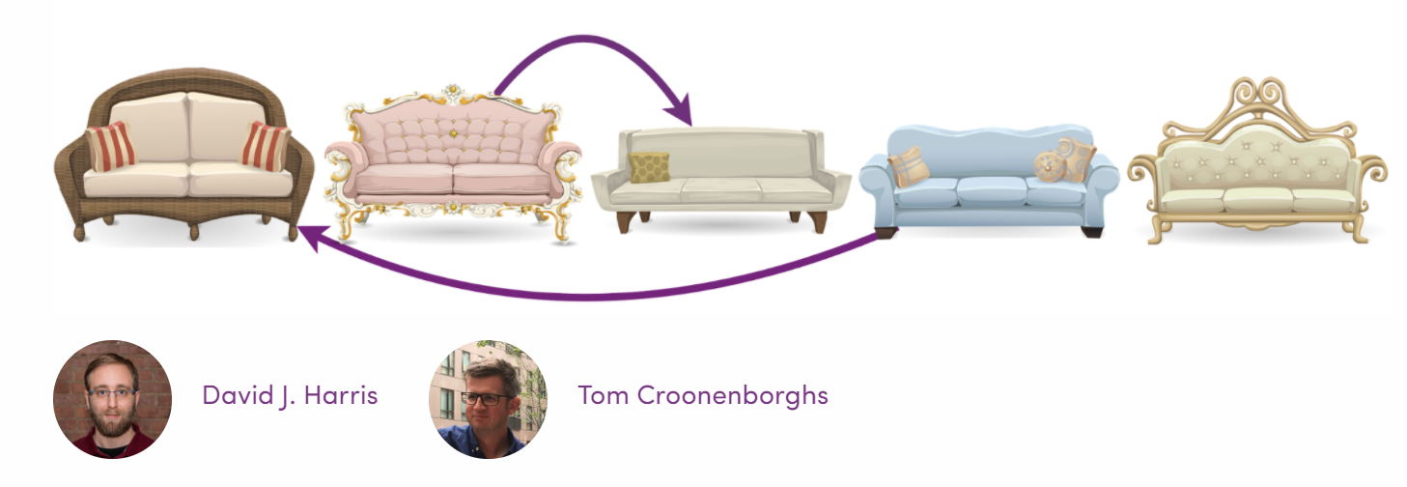

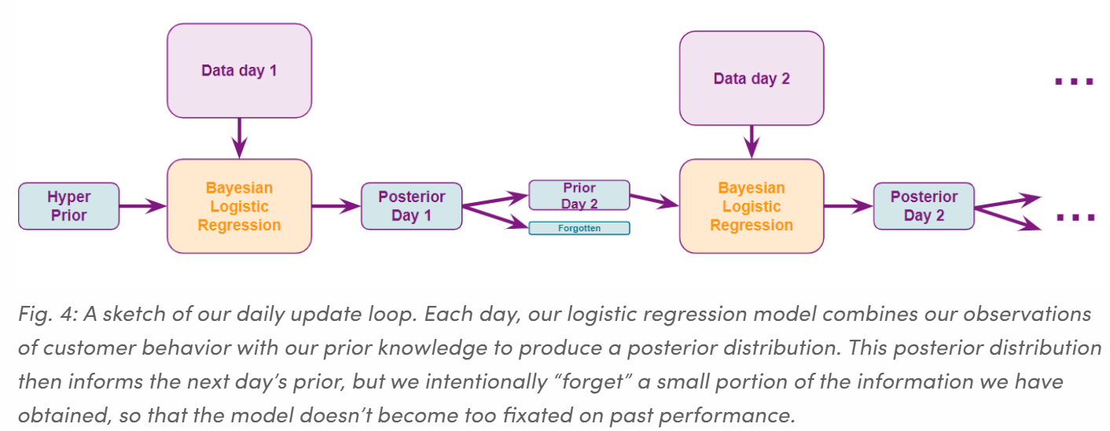
Prevalence of Bayesian Applications
Product Ranking & Recommendations at Wayfair
“Wayfair has a huge catalog with over 14 million items. Our site features a diverse array of products for people’s homes, with product categories ranging from ‘appliances’ to ‘décor and pillows’ to ‘outdoor storage sheds.’
“At Wayfair, we are constantly working to improve our customers’ shopping experiences…. This post features a new Bayesian system developed at Wayfair to (1) identify these products and
(2) present them to our customers.”
“Bayesian Product Ranking at Wayfair”, Jan 20, 2020.
The Enabling Feature of Bayesian Analysis:
Multilevel Modeling & Updating →
Personalization & Adaptation
Source:
“Bayesian Product Ranking at Wayfair”, Harris & Croonenborghs, Wayfair DataScience blog post Jan. 20, 2020
Notes:
This is an imperfect Venn diagram depicting the intersection of Bayesian Analysis with other fields, which themselves intersect – certainly differently than implied by the diagram. The portion of Bayesian Analysis not intersecting with the other fields is problematic, too.
But the point is: Although the most common way in which folks are introduced to Bayes’ Theorem is through Bayesian Statistics, Bayesian Analysis is much, much more than merely Bayesian Statistics.
I was introduced to Bayesian Analysis through Bayesian AI and then Bayesian Decision Analysis and finally Bayesian Statistics. So, I’ve always had a different take on Bayesian Analysis than my statistician counterparts. And, I’ve found it useful, as a more general mathematical modeler, to have emphasized the representation of deep domain knowledge and other information probabilistically; to perform reasoning under uncertainty in a principled, coherent, and consistent manner; and to intentionally drive to clear decision policies rather than to just slap a prior onto a likelihood function and process data as is done in a more conventional statistical modeling framework.
This is not to say there isn’t tremendous value in applying Bayesian Statistics– and certainly to-date, the greatest value realized in applications of Bayesian Analysis. It’s just that there is so much more to gain by going beyond that more conventional statistical view of Bayesian Analysis.
I hope to pique the interest of the readers/viewers to look into the ways in which Bayesian Analysis can deliver so much more.

Slide 12


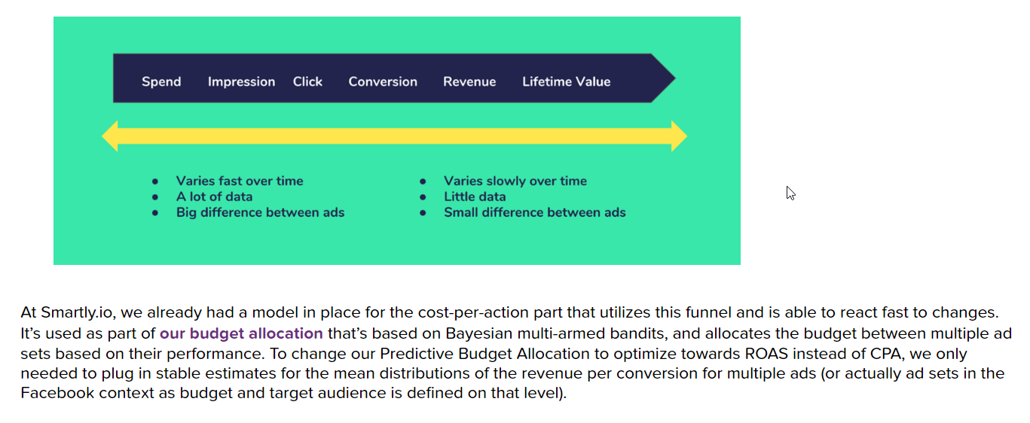
Prevalence of Bayesian Applications
Maximizing Return on Ad Spend at Smartly.io
“Overall, about one million euros of advertising spend on daily level is managed with our Predictive Budget Allocation. In future, we see that Stan or some other probabilistic programming language plays a big role in the optimization features of Smartly.io.”
“Tutorial: How We Productized Bayesian Revenue Estimation with Stan”, Markus Ojala, Jun 21, 2017.
The Enabling Feature of Bayesian Analysis:
Uncertainty Quantification →
Risk Assessment & Mitigation
Source:
“Tutorial: How We Productized Bayesian Revenue Estimation with Stan”,
Ojala, M., Smartly.io blog post 2017
Notes:
This is an imperfect Venn diagram depicting the intersection of Bayesian Analysis with other fields, which themselves intersect – certainly differently than implied by the diagram. The portion of Bayesian Analysis not intersecting with the other fields is problematic, too.
But the point is: Although the most common way in which folks are introduced to Bayes’ Theorem is through Bayesian Statistics, Bayesian Analysis is much, much more than merely Bayesian Statistics.
I was introduced to Bayesian Analysis through Bayesian AI and then Bayesian Decision Analysis and finally Bayesian Statistics. So, I’ve always had a different take on Bayesian Analysis than my statistician counterparts. And, I’ve found it useful, as a more general mathematical modeler, to have emphasized the representation of deep domain knowledge and other information probabilistically; to perform reasoning under uncertainty in a principled, coherent, and consistent manner; and to intentionally drive to clear decision policies rather than to just slap a prior onto a likelihood function and process data as is done in a more conventional statistical modeling framework.
This is not to say there isn’t tremendous value in applying Bayesian Statistics– and certainly to-date, the greatest value realized in applications of Bayesian Analysis. It’s just that there is so much more to gain by going beyond that more conventional statistical view of Bayesian Analysis.
I hope to pique the interest of the readers/viewers to look into the ways in which Bayesian Analysis can deliver so much more.

Slide 13



Prevalence of Bayesian Applications
Probabilistic Match-Making at Betterhalf.ai
Hidden
“’We use recursive probabilistic Bayes update algorithm to estimate and learn about the correct personality of users over time,’
says Betterhalf’s co-founder and CTO Rahul Namdev.”
“Marriages made in heaven with a little help from Bayes”,
Sriram Sharma, FactorDaily.com, May 14, 2018
The Enabling Feature of Bayesian Analysis:
Multilevel Modeling & Updating → Personalization & Adaptation
Source: About Us, Betterhalf.ai
Notes:
This is an imperfect Venn diagram depicting the intersection of Bayesian Analysis with other fields, which themselves intersect – certainly differently than implied by the diagram. The portion of Bayesian Analysis not intersecting with the other fields is problematic, too.
But the point is: Although the most common way in which folks are introduced to Bayes’ Theorem is through Bayesian Statistics, Bayesian Analysis is much, much more than merely Bayesian Statistics.
I was introduced to Bayesian Analysis through Bayesian AI and then Bayesian Decision Analysis and finally Bayesian Statistics. So, I’ve always had a different take on Bayesian Analysis than my statistician counterparts. And, I’ve found it useful, as a more general mathematical modeler, to have emphasized the representation of deep domain knowledge and other information probabilistically; to perform reasoning under uncertainty in a principled, coherent, and consistent manner; and to intentionally drive to clear decision policies rather than to just slap a prior onto a likelihood function and process data as is done in a more conventional statistical modeling framework.
This is not to say there isn’t tremendous value in applying Bayesian Statistics– and certainly to-date, the greatest value realized in applications of Bayesian Analysis. It’s just that there is so much more to gain by going beyond that more conventional statistical view of Bayesian Analysis.
I hope to pique the interest of the readers/viewers to look into the ways in which Bayesian Analysis can deliver so much more.

Slide 14
How do you perform
Bayesian Analysis –
What is the workflow & what are the tools?

Slide 15
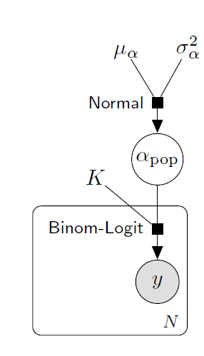
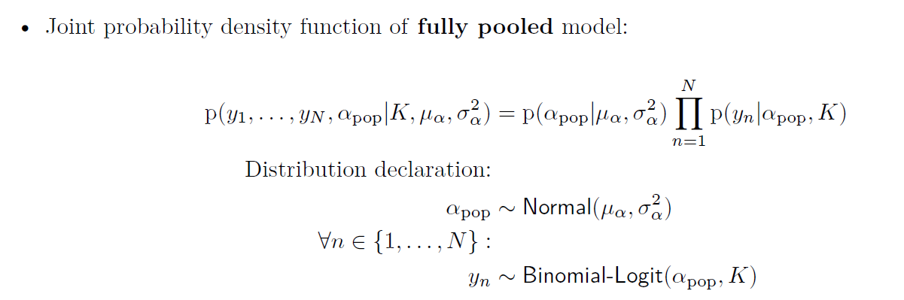
Bayesian Analysis
Fully pooled model
Adapted from: A Primer on Bayesian Multilevel Modeling using PyStan
By Chris Fonnesbeck; License: Apache, CC-BY 3.0 (text)
Example: Product ranking, model the probability that a given customer will order product n:
  p = 1/(1 + exp(-α_{pop}))
Hypothesis, H – unknown parameter: α_{pop} (“pop”=population-level parameter)
Evidence, E – given data:
  y_{n} = number of customers ordering product n
  K = number of times customers shown product n
Probabilistic Graphical Model (PGM):
Encodes our conditional independence (Markovian) assumptions about the joint probability distribution P(H,E). (See Judea Pearl & d-separation.)
The Bayesian network is a generative model suitable for
both simulation and inference.
P(H)
P(E|H)
All N subjects share the exact same population-level parameter.
P(H,E)
population-level parameter: α_{pop}
observations: y₁ y_{2 …} y_{N}
The factor graph of our Bayesian network.

Slide 16
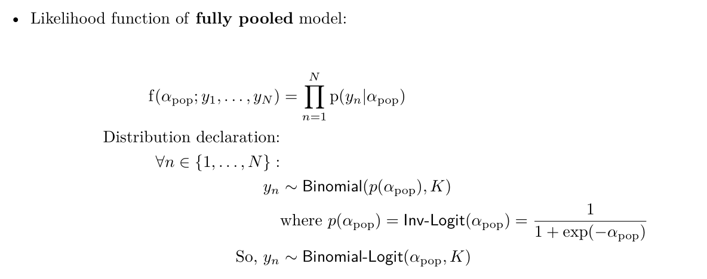
Bayesian Analysis
Logistic Regression: Frequentist vs. Bayesian
Hidden
Example: Product ranking, model the probability that a given customer will order product n:
  p = 1/(1 + exp(-α_{pop}))
Hypothesis, H – unknown parameter: α_{pop} (“pop”=population-level parameter)
Evidence, E – given data:
  y_{n} = number of customers ordering product n
  K = number of times customers shown product n
Frequentist Modeling
Bayesian Modeling
P(H,E)
P(H)
P(E|H)
P(H):
P(E|H):

Slide 17
Bayesian Analysis
Logistic Regression: Frequentist vs. Bayesian
Hidden
Example: Product ranking, model the probability that a given customer will order product n:
  p = 1/(1 + exp(-α_{pop}))
Hypothesis, H – unknown parameter: α_{pop}
Evidence, E – given data:
  y_{n} = number of customers ordering product n
  K = number of times customers shown product n
Likelihood is treated as a deterministic function of the parameters at fixed values of data – so not as a probability density function on the data.
Finds a single point estimate for parameters by applying an optimizer to maximize likelihood.
Assesses result (e.g., confidence intervals) under asymptotic assumptions (i.e., in the limit of infinite data) about the sampling process. Be wary of sparse data.
Result is a point estimate and assessment of the sampling process, not of the true parameters. So, we cannot make any direct probability statements about the true parameter values.
Probabilistic: The full joint probability distribution is specified.
Alternatives considered: Our priors on hypotheses capture plausibility of alternatives, providing domain knowledge in spite of sparse data.
Update beliefs w/evidence: Data updates the prior to the posterior distribution, formally accounting for strength of evidence, which concentrates our beliefs on most plausible values. But computation of posterior typically requires advanced algorithms.
Result is a full posterior distribution on our parameters. So, we quantify uncertainty and can make direct probability statements about the true parameter values, and all derived quantities, like predicted responses.
Frequentist Modeling
Bayesian Modeling
P(H,E)
P(H)
P(E|H)
P(H):
P(E|H):

Slide 18
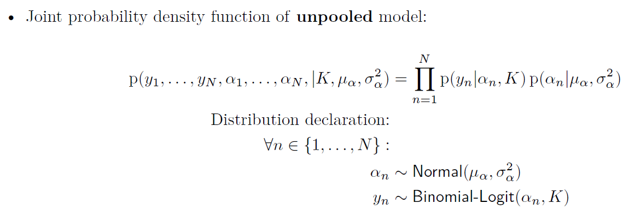
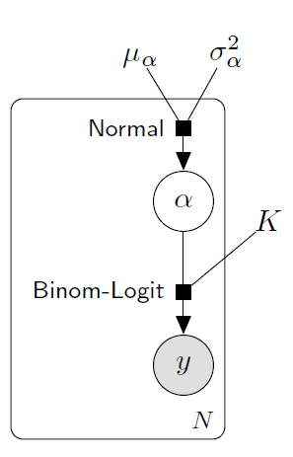
Bayesian Analysis
Fully pooled and unpooled models
Hidden
Adapted from: A Primer on Bayesian Multilevel Modeling using PyStan
By Chris Fonnesbeck; License: Apache, CC-BY 3.0 (text)
P(H,E)
P(H)
P(E|H)
P(H,E)
P(E|H)
P(H)
Each subject has its own subject-level parameter, independent of all other subjects.
All N subjects share the exact same population-level parameter.
population-level parameter: α_{pop}
subject-level parameters: α₁ α_{2 …} α_{N}
observations: y₁ y_{2 …} y_{N}
observations: y₁ y_{2 …} y_{N}

Slide 19
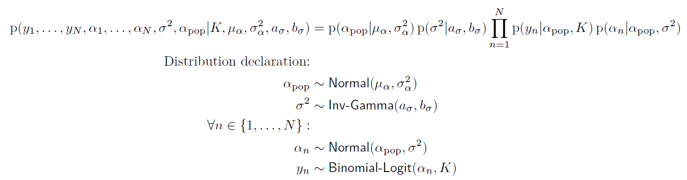
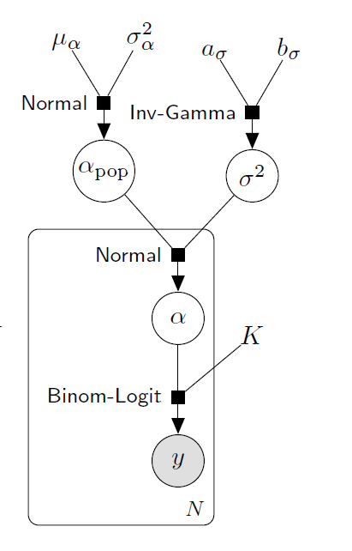
Bayesian Hierarchical/Multilevel Models
Partially pooled model
Adapted from: A Primer on Bayesian Multilevel Modeling using PyStan
By Chris Fonnesbeck; License: Apache, CC-BY 3.0 (text)
p(y_{n}|α_{n},K)p(α_{n}|α_{pop},σ²)
Each subject has its own parameter that depends upon the population-level parameter as the mean of its prior. So, all N subjects share information through the population-level parameter.
population-level parameters: α_{pop}, σ
subject-level parameters: α₁ α_{2 …} α_{N}
observations: y₁ y_{2 …} y_{N}
Notes:
I’m showing factor graphs rather than the DAG (directed acyclic graph) of the Bayesian network.

Slide 20
Tools for Bayesian Analysis
Probabilistic Programming Languages (PPL)
  Stan – C++ (Columbia University)
  Pymc3 – Python
  Pyro/NumPyro – Python/PyTorch (Uber AI)
  TensorFlow Probability – Python/TensorFlow (Google)
  Infer.NET – java (Microsoft)
  Gen – Julia (MIT)
Bayesian Statistical Modeling & Machine Learning
  R Packages: rstan (BHM), brms (BHM), rstanarm (BHM), blavaan (SEM),
  bnlearn (BN), gRain (BN), HydeNet (ID), causal, prophet – Facebook (STSF)
  Python Packages: pystan, prophet (STSF), pgmpy (PGM), bnlearn (BN)
  Commercial: BayesiaLab (BN), Hugin (BN), Netica (BN), AgenaRisk (ID)
PGM/BN = Probabilistic Graphical Models/Bayesian Networks
BHM = Bayesian Hierarchical/Multilevel Models
ID = Influence Diagrams
SEM = Structural Equations Models
STSF = Structural Time Series & Forecasting

Slide 21
Bayesian Workflow
(adapted from Fig. 1, "Bayesian Workflow", Prof. Andrew Gelman, et al.)
Markov Chain Monte Carlo (MCMC) Simulation
Perform Prior Predictive Checking
Priors are
acceptable?
Estimate Posterior
Specify Model
Y
N
Exploratory Data Analysis w/Visualization: yielding a network of candidate models
Address Computational Issues
Y
Validate Computation
Propose Another Model
Joint probability verification
Continue
with Model?
Computational diagnostics checking
N
Model validation
N
N
N
Apply Model
Found a suitable Model?
Compare Models
Model is
trustworthy?
Evaluate Model
Computation
is valid?
Y
Y
Y
Notes:
Assumes eventually will find a suitable model. Could add a decision node on the “N” outlet of “Found a suitable Model?” that says, “Continue modeling?”, with “Y” outlet going to “Propose Another Model” and “N” outlet going to a terminal leaf node “STOP: Failed to find suitable model”.
Of the 3 loops (purple arrows), model validation is the only one that this workflow has in common with traditional statistical/data science workflows. The joint probability verification is unique to Bayesian analysis as we represent everything probabilistically and require a prior distribution in concert with the likelihood distribution. The computational diagnostics checking is also unique to Bayesian analysis because of the MCMC simulation methods used to infer the posterior distribution.

Slide 22
How to do Bayesian Analysis?
Example: Generalized linear multilevel model
Hidden
“Bayesian linear mixed models using Stan: A tutorial for psychologists, linguists, and cognitive scientists”,
T. Sorensen, S. Hohenstein & S. Vasishth, arXiv preprint, arXiv:1506.06201 (2015).
  Excerpt:
  “This paper was written using a literate programming tool, knitr (Xie, 2015); this integrates documentation for the accompanying code with the paper. The knitr file that generated this paper, as well as all the code and data used in this tutorial, can be downloaded from our website:
  https://www.ling.uni-potsdam.de/~vasishth/statistics/BayesLMMs.html
  In addition, the source code for the paper, all R code, and data are available on github at: https://github.com/vasishth/BayesLMMTutorial”.

Slide 23
How to do Bayesian Analysis?
Example: Generalized linear multilevel model
Hidden
“Finally! Bayesian Hierarchical Modelling at Scale"
Florian Wilhelm, Inovex blog post, Mar. 3, 2021
  Excerpt:
  “In this blog post, I want to draw your attention to the somewhat dusty Bayesian Hierarchical Modelling. Modern techniques and frameworks allow you to finally apply this cool method on datasets with sizes much bigger than what was possible before and thus letting it really shine.”

Slide 24
Bayesian Workflow
1. Specify Model
Hidden
Specify Model
Perform Prior Predictive Checking
Priors are
acceptable?
Estimate Posterior
Y
N
Address Computational Issues
Propose Another Model
Y
Validate Computation
Continue
with Model?
N
N
N
N
Apply Model
Found a suitable Model?
Compare Models
Model is
trustworthy?
Evaluate Model
Computation
is valid?
Y
Y
Y
Problem Statement*
  We wish to estimate the success rate π of our promotional ad campaign amongst our target population. We have data from a small test amongst N=16 customers, in which we succeeded with n=6.
Generative Model
  Base Model: n ~ Binomial(N,π); prior p(π)
Weakly Informative Priors
  Previous experience tells us that typically π~0.30 and almost always our campaigns have π<0.80; we’ll use π ~ Beta(α,β) and set the hyperparams assuming μ=0.30 and let 97.5%-ile = 0.80; so use α=0.96, β=2.24
Just as with the simple Mosaic plot examples, this gives us the joint distribution, but as a simulator rather than a 2D plot. And applying Bayes Rule is, again, as simple as selecting the generated hypotheses (parameter) values that coincide with the same generated success rates as the evidence, in this case n.
*Adapted from Rasmus Baath: “Bayesian Analysis Tutorial, Part 1: What”; YouTube (2017).

Slide 25
Prior Predictive Checking
1. Simulation of hypotheses given evidence using joint probability distribution
Hidden
> library(magrittr)
> library(tidyverse)
> library(brms)
> df <- tibble(n=6,N=16)
> sim_beta <- brm(
formula = n | trials(N) ~ 1,
family = binomial(link="identity"),
data = df,
prior = set_prior(prior="beta(0.96,2.24)",class="Intercept"),
sample_prior = "only"
)
> sim_beta
Family: binomial
Links: mu = identity
Formula: n | trials(N) ~ 1
Data: df (Number of observations: 1)
Samples: 4 chains, each with iter = 2000; warmup = 1000; thin = 1;
total post-warmup samples = 4000
Population-Level Effects:
Estimate Est.Error l-95% CI u-95% CI Rhat Bulk_ESS Tail_ESS
Intercept 0.32 0.23 0.02 0.82 1.01 454 871
Samples were drawn using sampling(NUTS). For each parameter, Bulk_ESS
and Tail_ESS are effective sample size measures, and Rhat is the potential
scale reduction factor on split chains (at convergence, Rhat = 1).
Tool:
R package `brms`

Slide 26
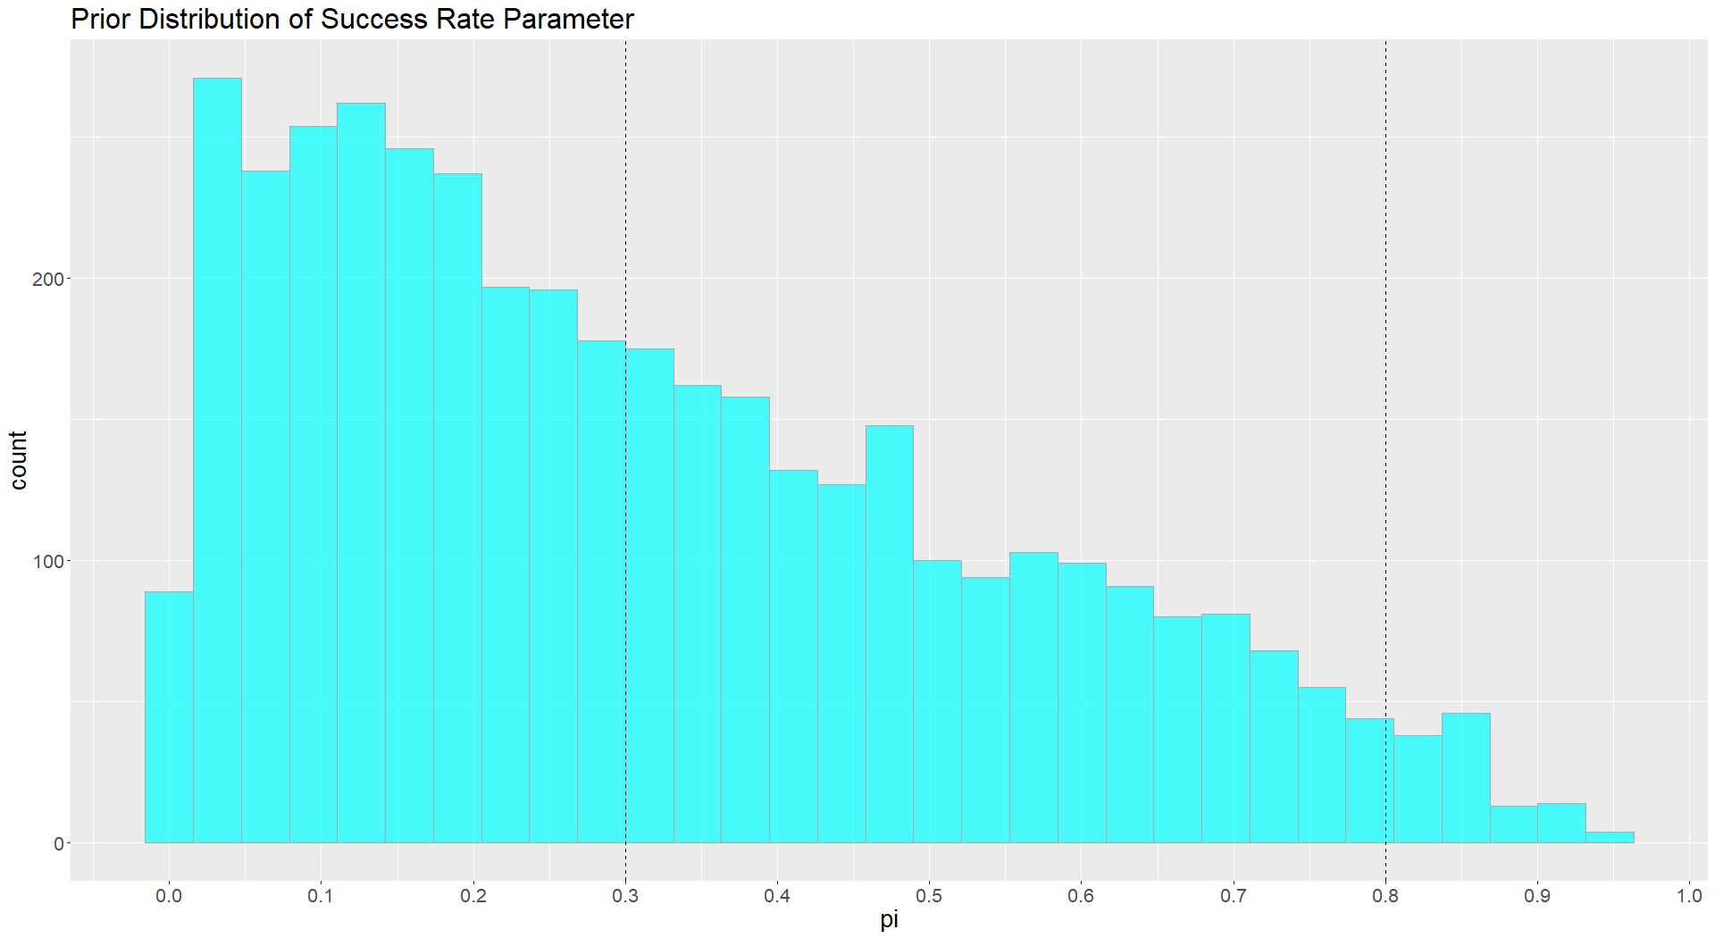
Hidden
Mean = 0.30
97.5%-ile = 0.80

Slide 27
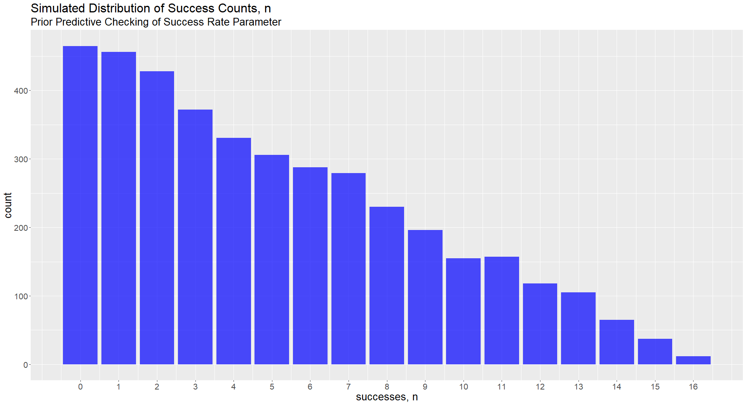
Hidden
Data
n=6

Slide 28
Estimating Posterior
Hidden
> mod_beta <- update(sim_beta,sample_prior="no")
> mod_beta
Family: binomial
Links: mu = identity
Formula: n | trials(N) ~ 1
Data: df (Number of observations: 1)
Samples: 4 chains, each with iter = 2000; warmup = 1000; thin = 1;
total post-warmup samples = 4000
Population-Level Effects:
Estimate Est.Error l-95% CI u-95% CI Rhat Bulk_ESS Tail_ESS
Intercept 0.36 0.11 0.17 0.58 1.00 1537 1770
Samples were drawn using sampling(NUTS). For each parameter, Bulk_ESS
and Tail_ESS are effective sample size measures, and Rhat is the potential
scale reduction factor on split chains (at convergence, Rhat = 1).
Warning message:
There were 6 divergent transitions after warmup. Increasing adapt_delta above 0.8 may help.
See http://mc-stan.org/misc/warnings.html#divergent-transitions-after-warmup
> plot(mod_beta)

Slide 29
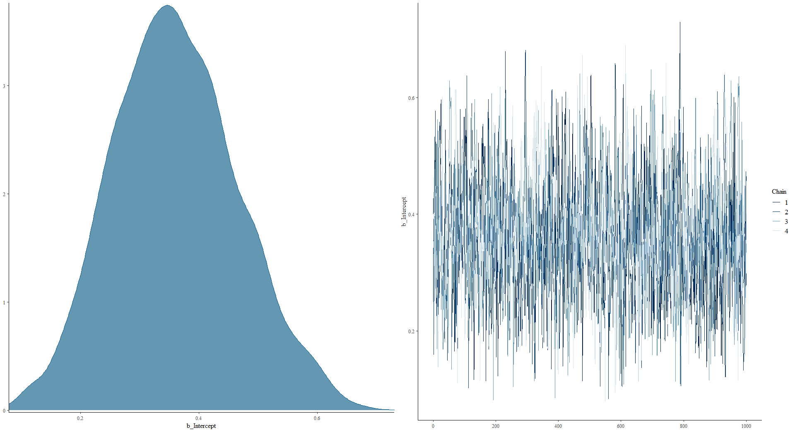
Posterior Density & Monte Carlo Trace Plot for success rate parameter π
Hidden

Slide 30
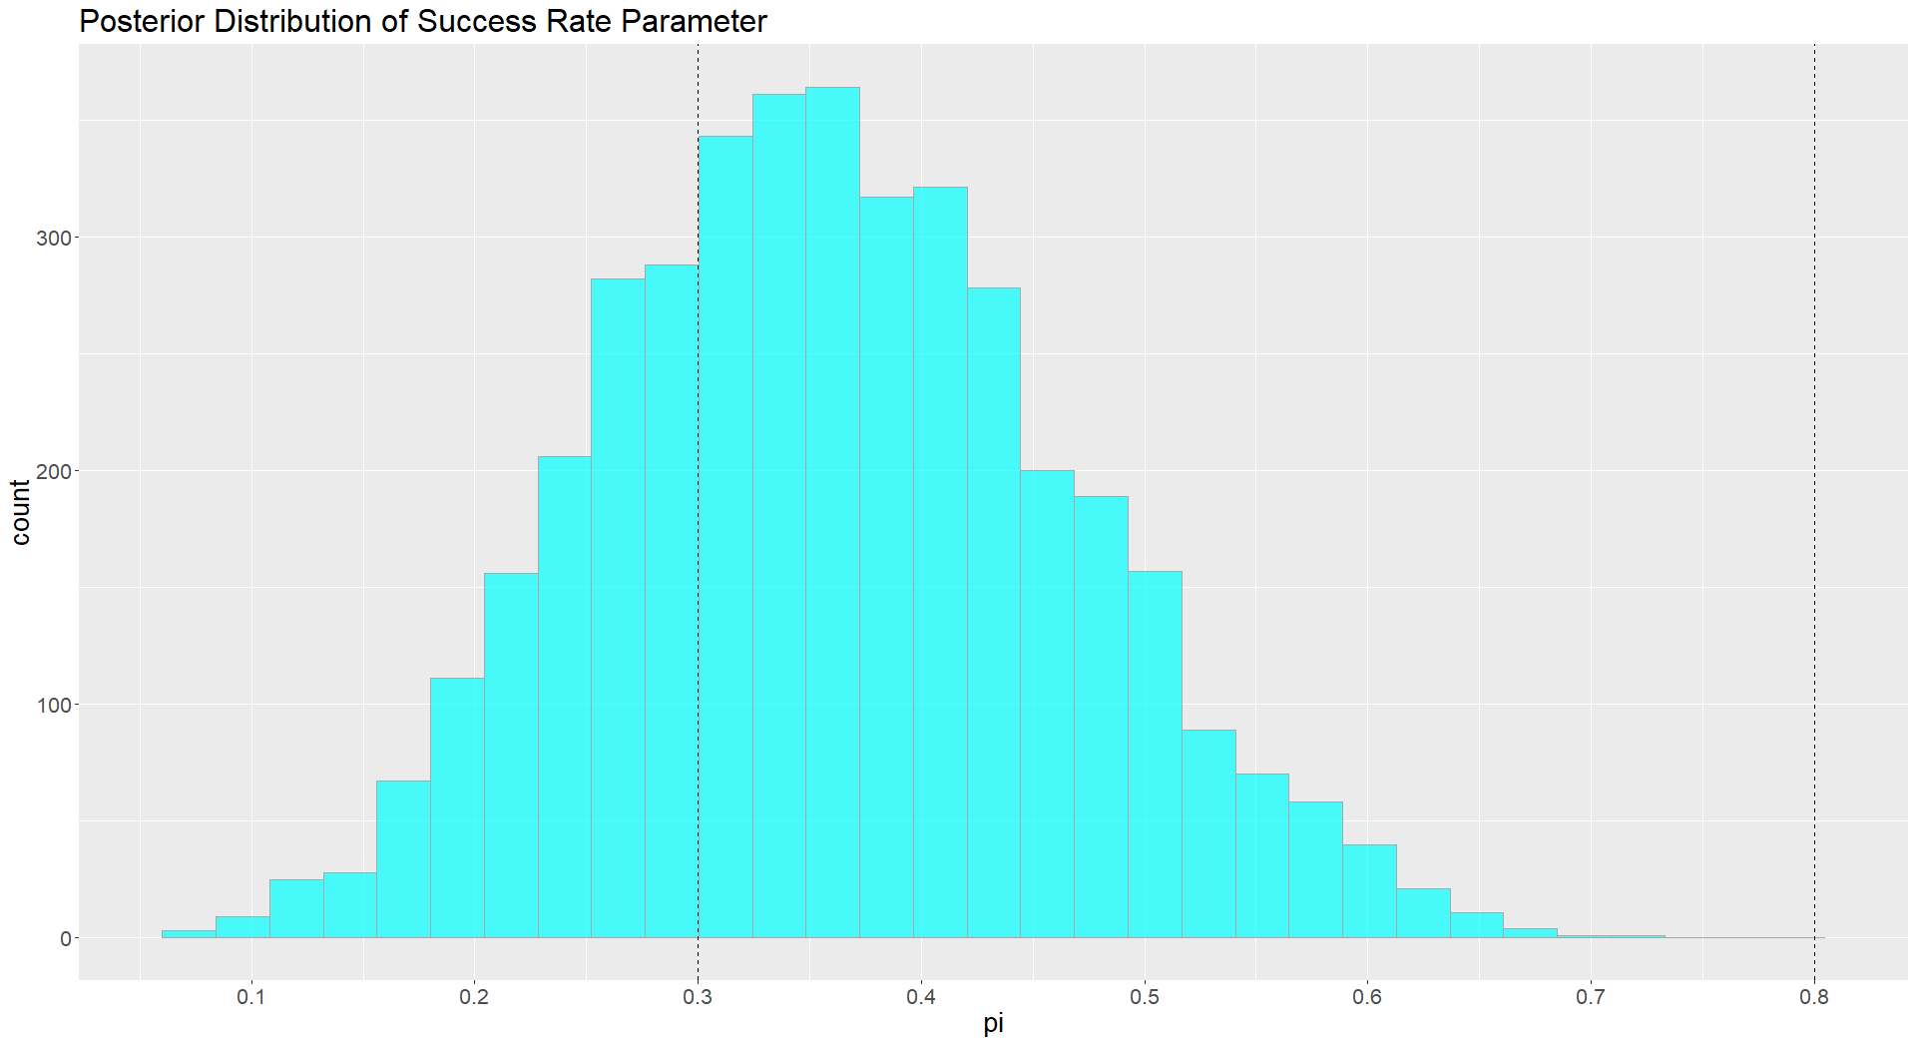
Hidden
Posterior
Mean = 0.36
Prior
Mean = 0.30
Prior
97.5%-ile = 0.80
Max.Like.
Est. = 0.375

Slide 31
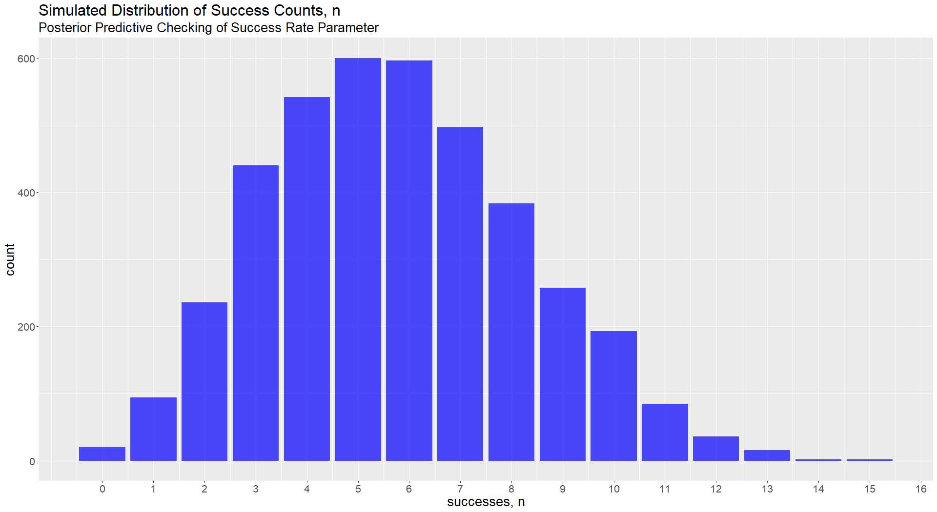
Hidden
Data
n=6

Slide 32
When is using Bayesian Analysis most strongly motivated?

Slide 33
Motivation for Bayesian Analysis:
Turn to Bayesian methods when faced with
Data=“Complex”, Model=“Complex”, or Decision=“Complex”
“Simple”
“Complex”
Data
  Single source
  Single variable types/distribution families
  Tabular & Ample – “Big Data”
    Non-missing
    Regular, exchangeable
Model
  Observations linked to observations (Modeling the Data)
  Empirical structure
    Single-level
    Correlative (acausal)
  Single hypothesis
  Component-level estimation; Low-level integration
Decision
  Deterministic assumptions
  Modal/point estimate solutions
  Predictive inference (What will happen?)
  Single objective, Static
Data
  Multiple sources
  Multiple variable types/distribution families
  Ragged & Sparse
    Missing
    Multigranular aggregation
Model
  Latent spaces (Modeling the Domain)
  Causal structure
    Multi-level
    Mechanisms
  Mixture of phenomena/Multi-Hypothesis
  System-level integration
Decision
  Reasoning under uncertainty (UQ)
  Risk analysis
  Explanatory inference (Why did it happen?)
  Multi-Objective, Dynamic updating
Homogeneous
Heterogeneous
Data-to-Data
True-to-True
Deterministic Predictions
Probabilistic Explanations
Notes:
DLNN: “Multi-Modal”, e.g., images and text; video and audio; etc.

Slide 34
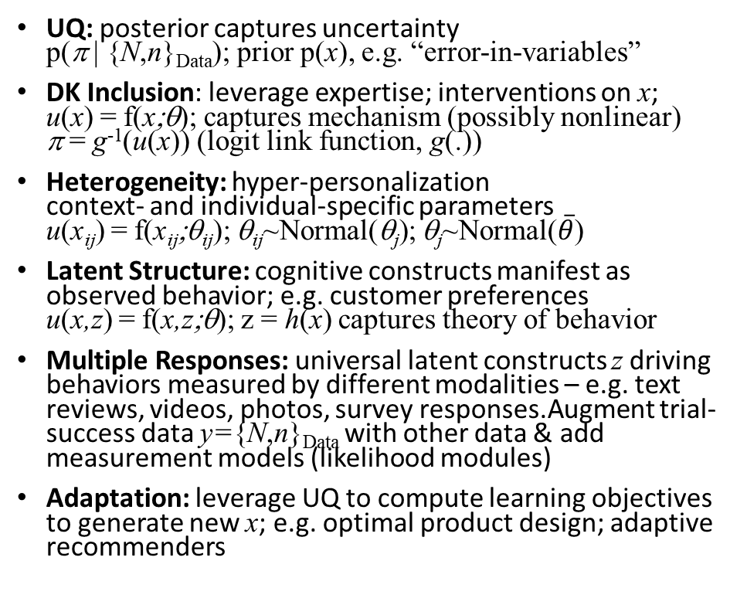
Use of Bayesian Analysis is Compelled by…
Hidden
… These Issues
Example: Predicting Success Rates
Base Model: n ~ Binomial(N,π); prior p(π)
Uncertainty Quantification (UQ)
  Sparsity & Missing Data
  Risk & Decision Analysis; Post-Inference App: Explanations; Confirmations
Domain Knowledge (DK) Inclusion
  Expertise; Causality/Structural/State Space/Mechanism Representation
Heterogeneity
  Multi-level Behavior (context-specific; individual-specific)
Latent Structure
  Factor Analysis; Conceptual Embeddings; Underlying Cognitive Constructs
Multiple Responses
  Information Fusion;
  Multimodal Data Streams
Adaptation (Bayesian Updating)
  Autonomous & Active Learning Systems; Adaptive Questionnaires; Adaptive Experiments
UQ: posterior captures uncertainty
p(π | {N,n}_{Data}); prior p(x), e.g. “error-in-variables”
DK Inclusion: leverage expertise; interventions on x;
u(x) = f(x;θ); captures mechanism (possibly nonlinear)
π = g⁻¹(u(x)) (logit link function, g(.))
Heterogeneity: hyper-personalization
context- and individual-specific parameters
u(x_{ij}) = f(x_{ij};θ_{ij}); θ_{ij}~Normal(θ_{j}); θ_{j}~Normal($\overline{θ}$)
Latent Structure: cognitive constructs manifest as observed behavior; e.g. customer preferences
u(x,z) = f(x,z;θ); z = h(x) captures theory of behavior
Multiple Responses: universal latent constructs z driving behaviors measured by different modalities – e.g. text reviews, videos, photos, survey responses.Augment trial-success data y={N,n}_{Data} with other data & add measurement models (likelihood modules)
Adaptation: leverage UQ to compute learning objectives to generate new x; e.g. optimal product design; adaptive recommenders

Slide 35
Bayesian Analysis Beyond Predictive Models
Decision Support & Automated Reasoning Systems
Hidden
Confirmatory, Explanatory &
Causal Inference
Generalized Bayes Factors & Weight of Evidence
Most Compelling Confirmation (MCC)
Most Relevant Explanation (MRE)
Causal Inference
Risk Assessment &
Decision Analysis
Uncertainty Quantification
Utility Functions
Costs/Rewards
Learning, Adaptation &
Content Generation
Bayesian Machine Learning (Model-Based ML)
Bayesian Optimization
Reinforcement/Active Learning
Adaptive Experiments
Computational Creativity

Slide 36
Where can you learn more about Bayesian Analysis?

Slide 37



Resources on Bayesian Analysis
3Blue1Brown
Basic Concepts: YouTube videos
  “Bayes Theorem, and making probability intuitive” [15′45″],
  “The quick proof of Bayes’ Theorem” [3′47″], and
  “The medical test paradox: Can redesigning Bayes rule help?” [21′13″]
  "You Know I’m All About that Bayes: Crash Course Statistics #24“ [12′04″] and
  “Bayes in Science and Everyday Life: Crash Course Statistics #25" [11′13″]
  For more philosophical takes on Bayesian reasoning, check out these YouTube videos by Julia Galef:
  “Bayes: How one equation changed the way I think” [3′28″]
  “A visual guide to Bayesian thinking” [11′24″]
How To: YouTube videos & blogs
  Rasmus Baath’s 3-part Tutorial “Bayesian Analysis” (1. What [29′29″], 2. Why [22′59″], 3. How [37′51″])
  YouTube: “Corrie Bartelheimer: A Bayesian Workflow with PyMC and ArviZ | PyData Berlin 2019” [29′28″] (code is here)
  Kurt, Will, “Count Bayesie” blog series, “A Guide to Bayesian Statistics”, May 2, 2016
  Fang & van de Schoot, “Intro to Bayesian (Multilevel) Generalised Linear Models (GLM) in R with brms” (2019)
  Stan Development Team: Tutorials – Learn to use Stan; & Case Studies – Open-source methods & models
Latest Research & Applications
  Michael Thompson’s Flipboard e-zine mashup: “Bayesian”
  Prof. Andrew Gelman’s blog:
  “Statistical Modeling, Causal Inference, and Social Science”
CrashCourse
If you want to see how it’s done, go here.
Stan

Slide 38
Readings: Articles & Book Excerpts
Hidden
Statistics
  Kruschke, J. K. “Chapter 2, Introduction: Credibility, Models, and Parameters”, Doing Bayesian Data Analysis, 2nd Edition: A Tutorial with R, JAGS, and Stan. Waltham, MA: Academic Press (2015).
  Richard McElreath “Statistical Rethinking”
  Gabry et al. “Visualization in Bayesian Workflow”
  Gelman et al. “Bayesian Workflow”
  Gelman et al. “The Prior Can Often Only Be Understood in the Context of the Likelihood”
  Michael Betancourt, “A Conceptual Introduction to Hamiltonian Monte Carlo Simulation”
AI/ML
  Chris Bishop (Microsoft Research) “Model-Based Machine Learning”
  Tenenbaum, et al., How to Grow a Mind: Statistics, Structure, and Abstraction (PDF), Science, 2011; lecture video
  Daphne Koller & Nir Friedman “Probabilistic Graphical Models” (excerpt)
  Norman Fenton & Martin Neil “Risk Assessment & Decision Analysis with Bayesian Networks” (sample chapters)
I draw heavily upon these in the graduate course I teach on Bayesian Analysis at the Univ. of Cincinnati.

Slide 39
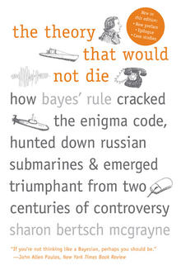
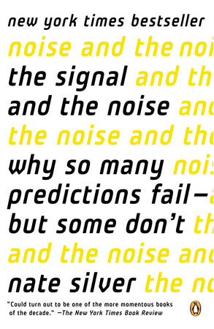
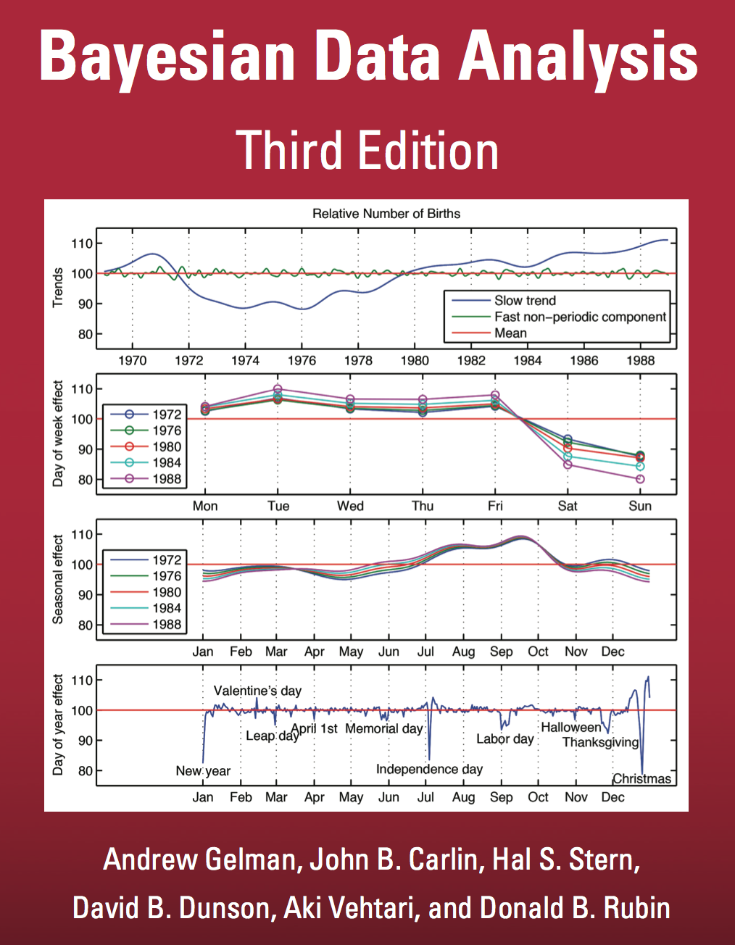
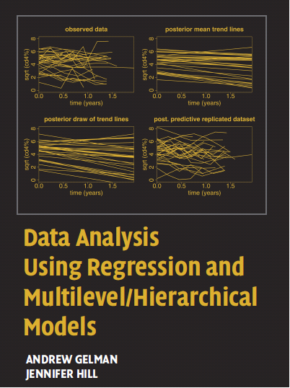
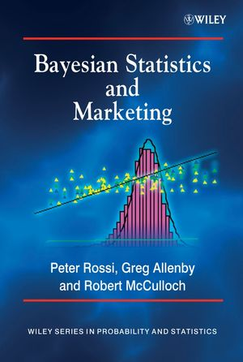

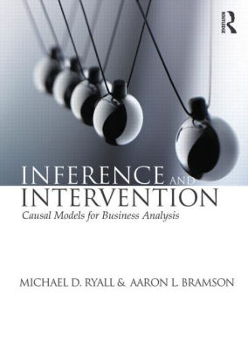
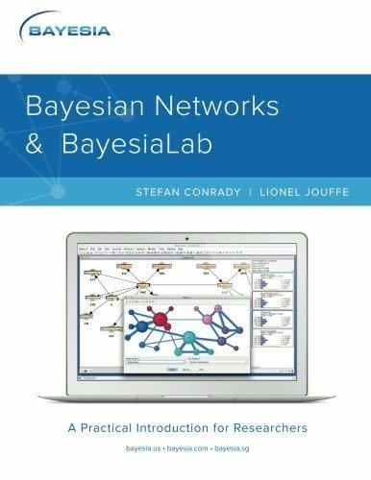
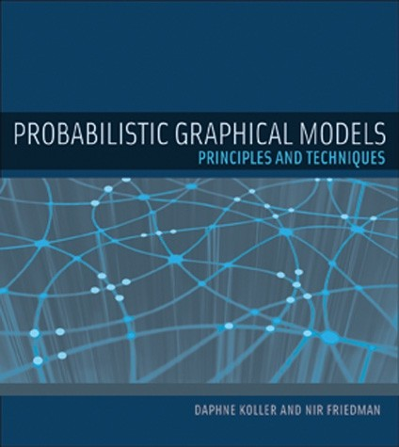
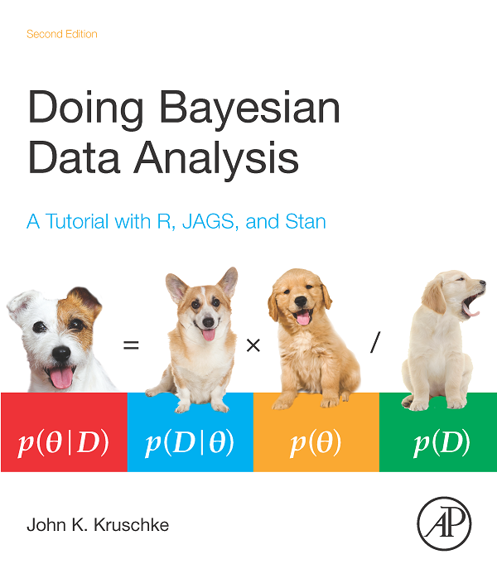
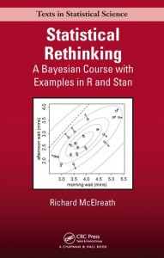
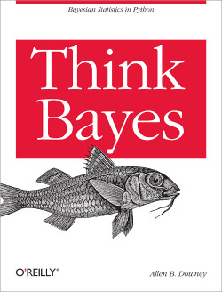
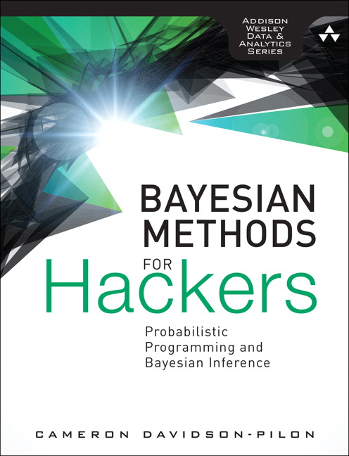
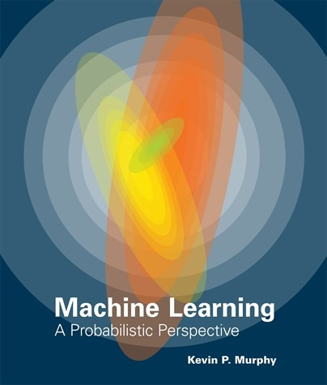
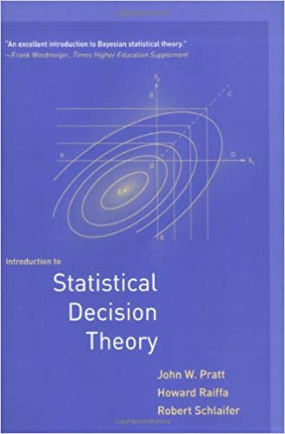
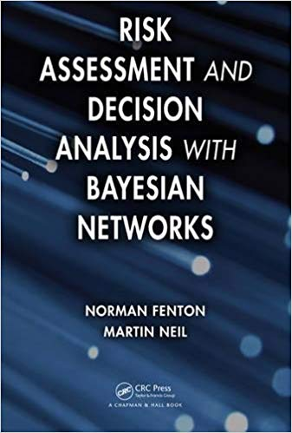
Bayesian Theory & Practice
(Each image is hyperlinked to the book’s website, most of which include excerpts & example code)
Hidden
Popular Press
Causal Inference
*
*
*
*
Bayesian Statistics
*
Bayesian Machine Learning
Bayesian Decision Analysis
*Little if any theory & math; many applied examples
Especially good for hands-on learning.

Slide 40

Thank you!

